Slide 1
R-loop signatures between HPV+ and HPV- cervical cancers at single-cell resolution
Presented by: Steven Brooks

Slide 2
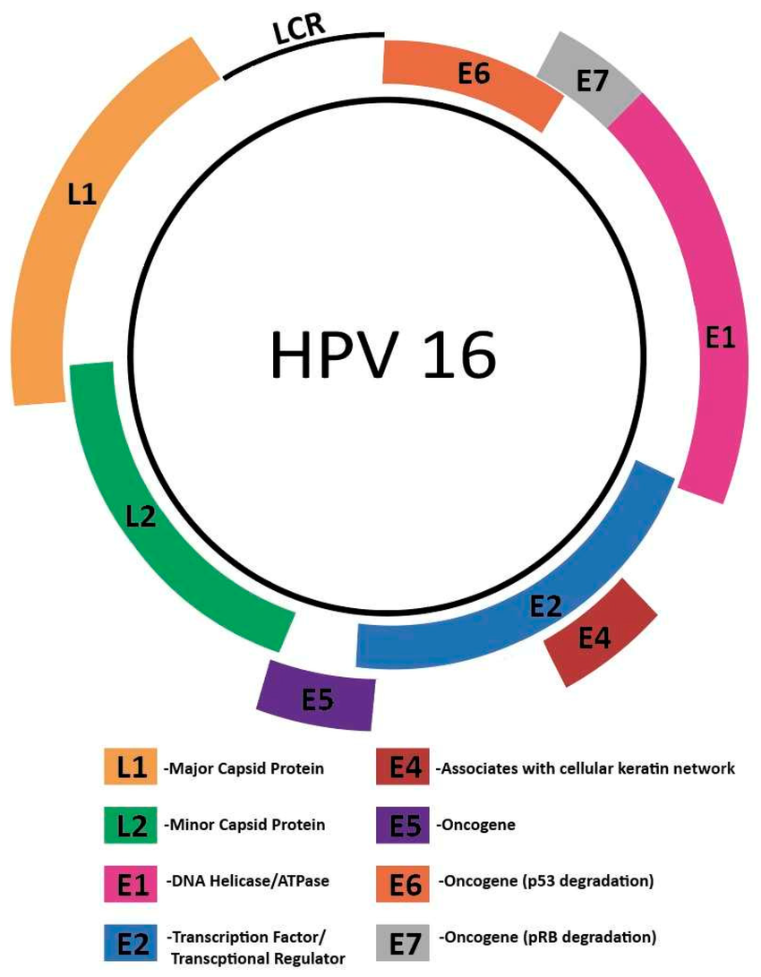
What is HPV?
Biology Background
High-risk human papillomaviruses, particularly HPV16, are the primary cause of nearly all cervical cancers, and their viral oncoproteins E6 and E7 drive malignant transformation by inactivating the tumor suppressors p53 and Rb. Fun fact: The HPV vaccine is essentially the empty capsid protein L1.
10.3390/cancers15143692

Slide 3
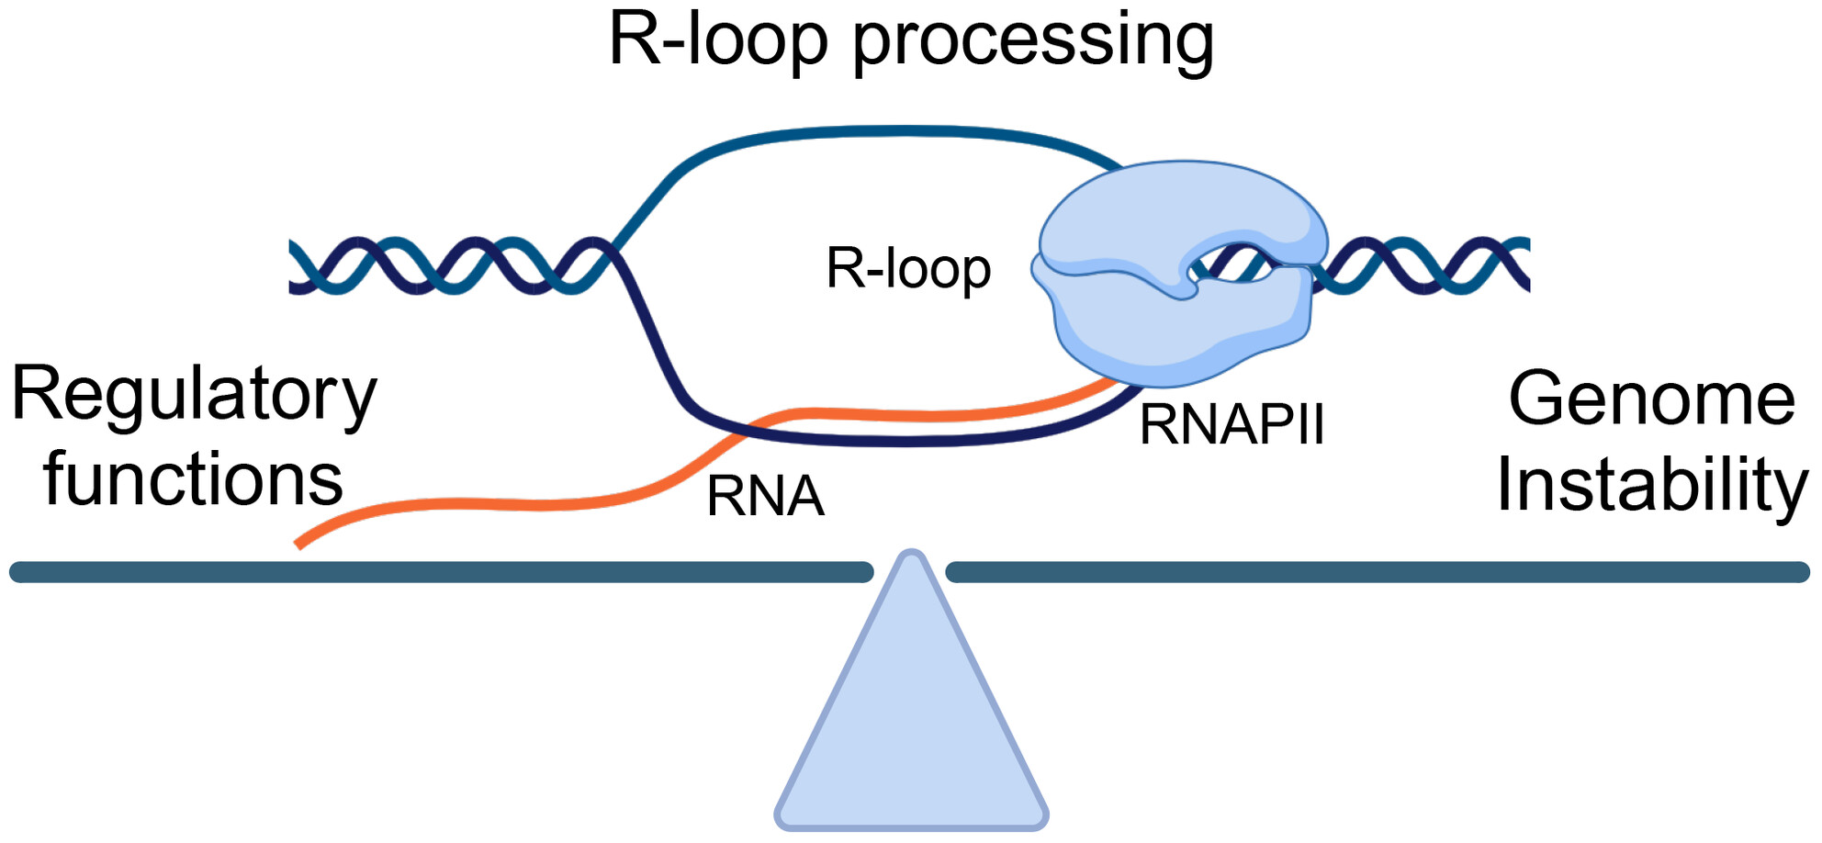
What is an R-loop?
Biology Background
An R-loop is a three-stranded DNA:RNA hybrid structure.
https://doi.org/10.1002/1873-3468.14947

Slide 4
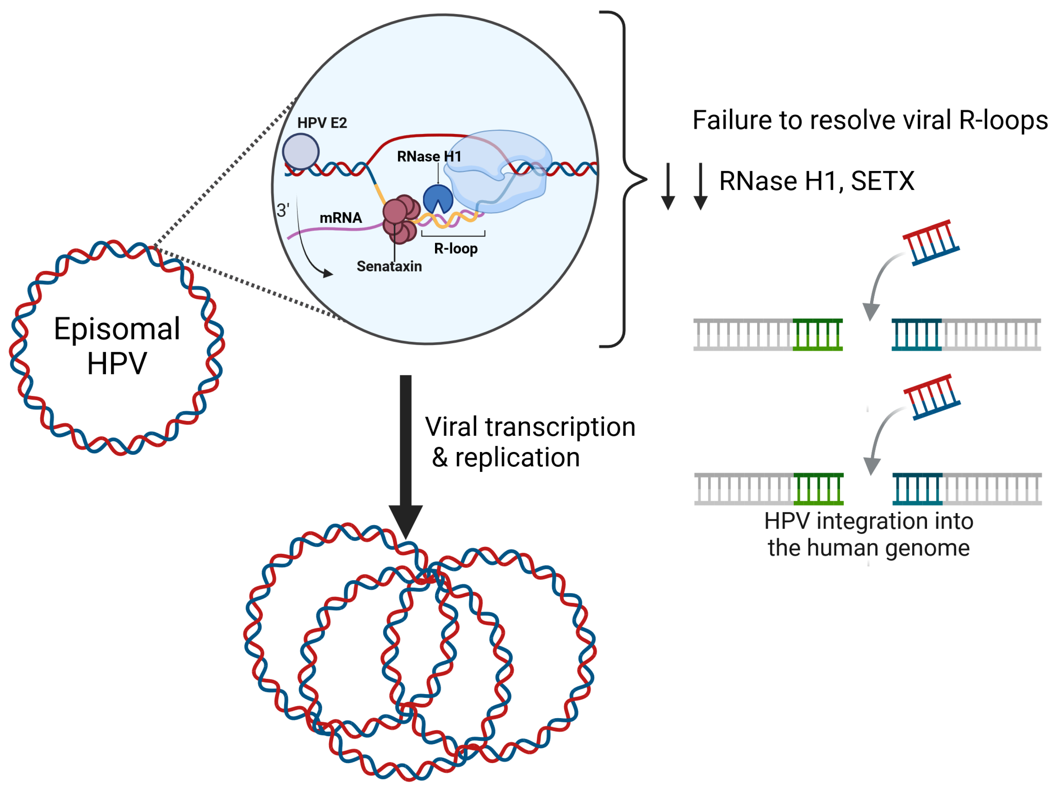
HPV uses R-loops to integrate into the host.
Motivation
HPV hijacks host transcription and replication to create R-loops (RNA–DNA hybrids) that control whether the viral genome stays episomal or integrates and damages DNA.
These R-loops link HPV infection to genome instability, immune evasion, and cancer risk, making them attractive biomarkers and therapeutic targets.
https://doi.org/10.3390/pathogens13100863
Notes:
During HPV transcription and replication, E2 works with the host (RNase H1 and Senataxin) to clear R-loops on the viral episome.
If these R-loops aren’t resolved (e.g., when RNase H1/SETX levels drop), DNA damage increases and HPV is more likely to integrate into the human genome.

Slide 5
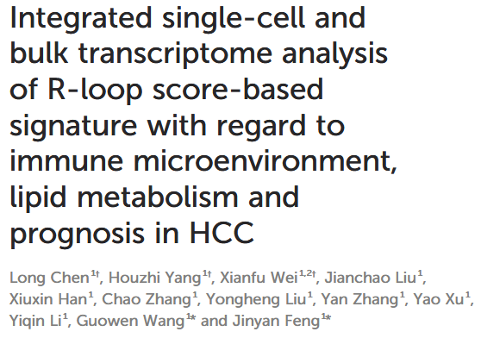
Prior Art
Rationale
Chen et al. used HCC (Hepatocellular carcinoma – liver cancer) scRNA-seq data to build an R-loop score.
Showed R-loop scores are: -Higher in tumor vs. normal -Higher in HBV+ patients (hepatitis B virus) -Associated with immunosuppressive tumor micro-environment We will apply this R-loop score idea today. Instead of HBV and liver cancer, we will try HPV and cervical cancer.
https://doi.org/10.3389/fimmu.2024.1487372

Slide 6
Hypotheses
H1: HPV-positive tumors have higher R-loop scores (based on RLRGs regulator genes ) than HPV-negative tumors in malignant cells.
H2: In HPV-positive tumors, high R-loop scores are associated with:
higher T cell exhaustion signatures in CD8 T cells
lower antigen presentation (MHC) in malignant cells
overall more immunosuppressive TME

Slide 7
Methods
Pull a cervical cancer scRNA dataset with HPV+ and HPV- patients from GEO.
Perform Seurat workflow & QC & Harmony Integration.
Obtain R-loop scores per cell using R-loopBase.
Compare HPV+ and HPV- tumors using R-loop scores.
Analyze tumor microenvironment (TME) and tie R-loop scores to TME metrics.

Slide 8
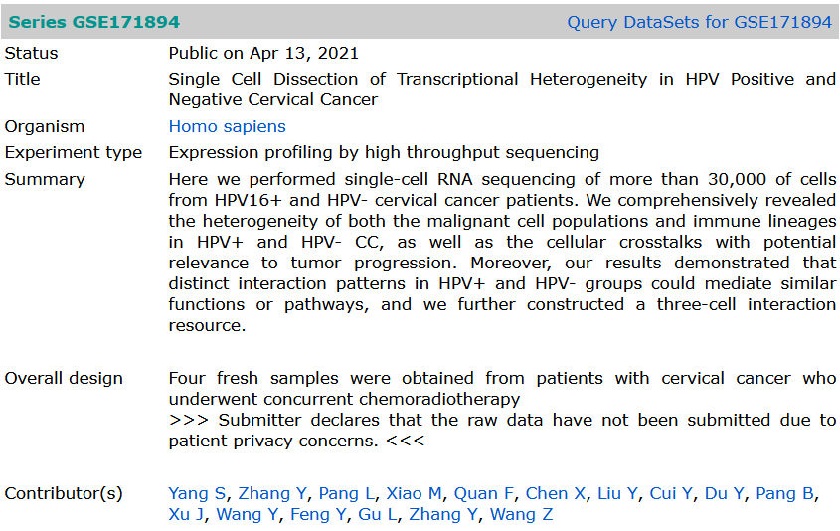
The Dataset
scRNA.
N = 4.
2 HPV+ and 2 HPV-.
GEO: GSE171894
PMID: 38482016

Slide 9
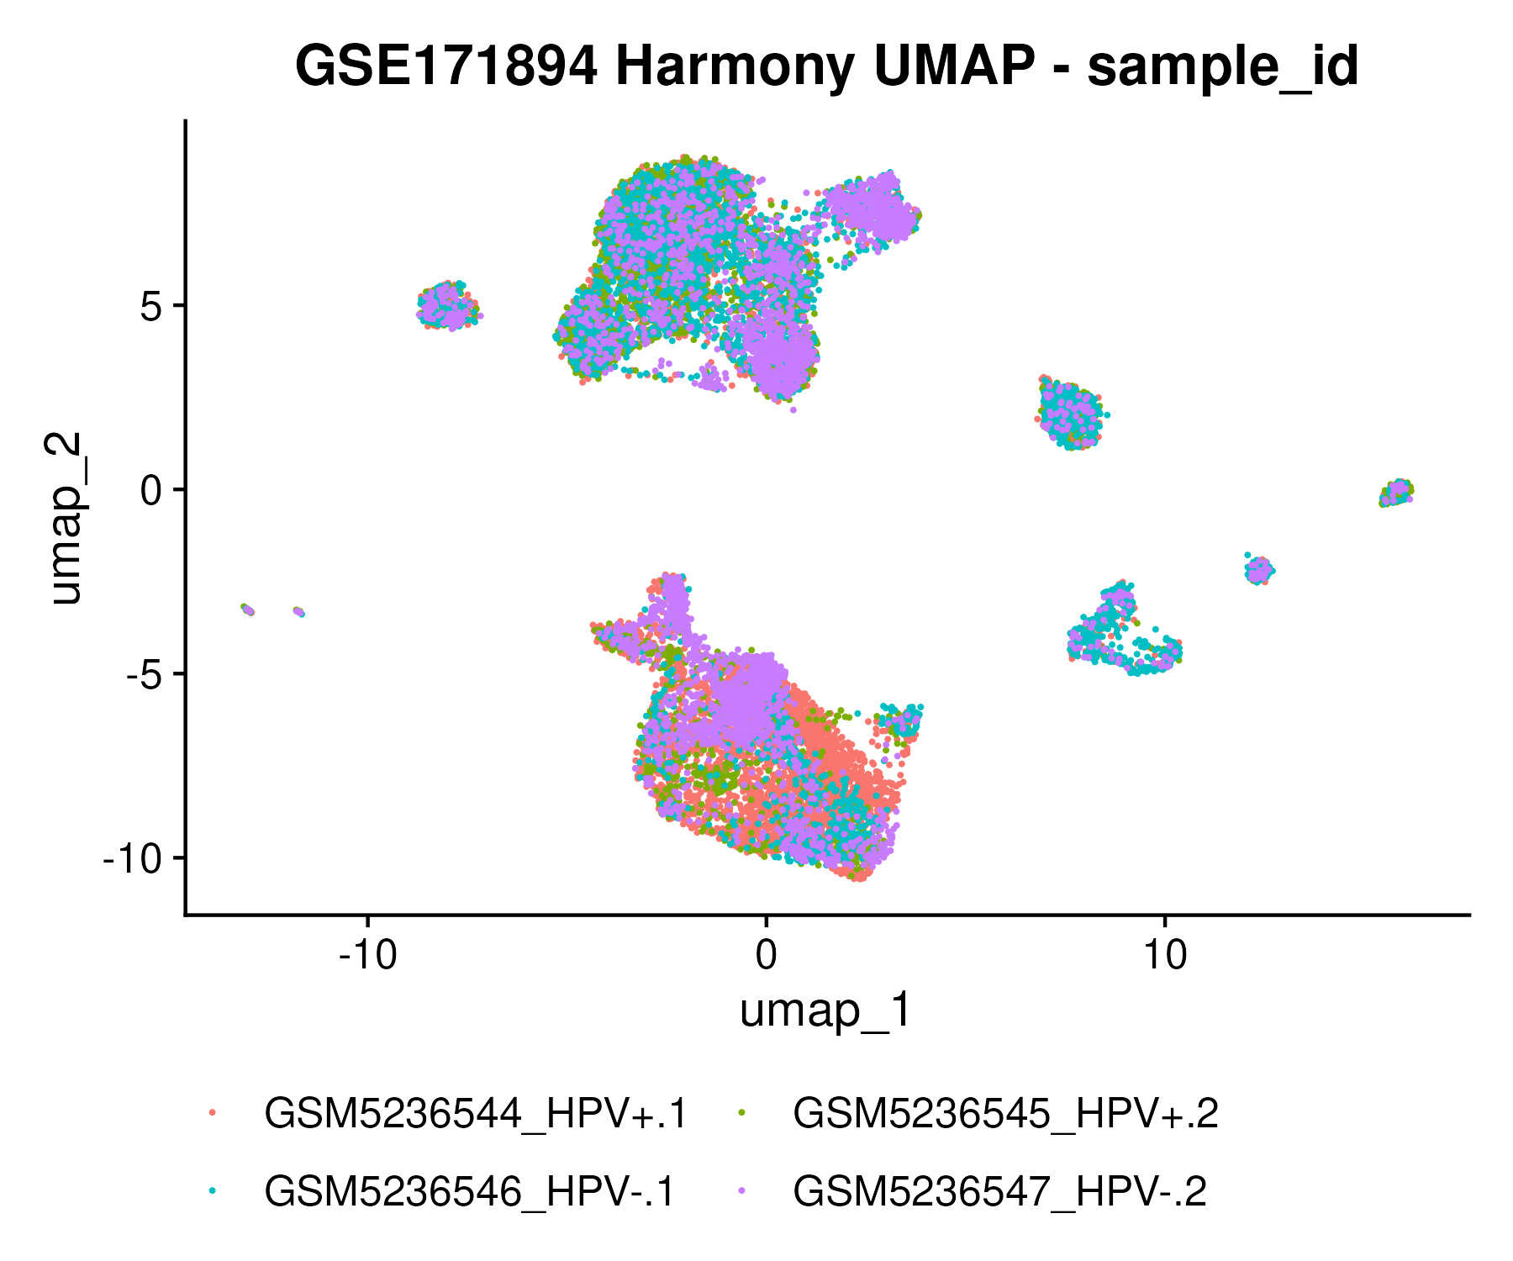
Integration across samples appears okay.
Differences in cluster abundances are largely explained by HPV status.
No sample specific clusters.

Slide 10
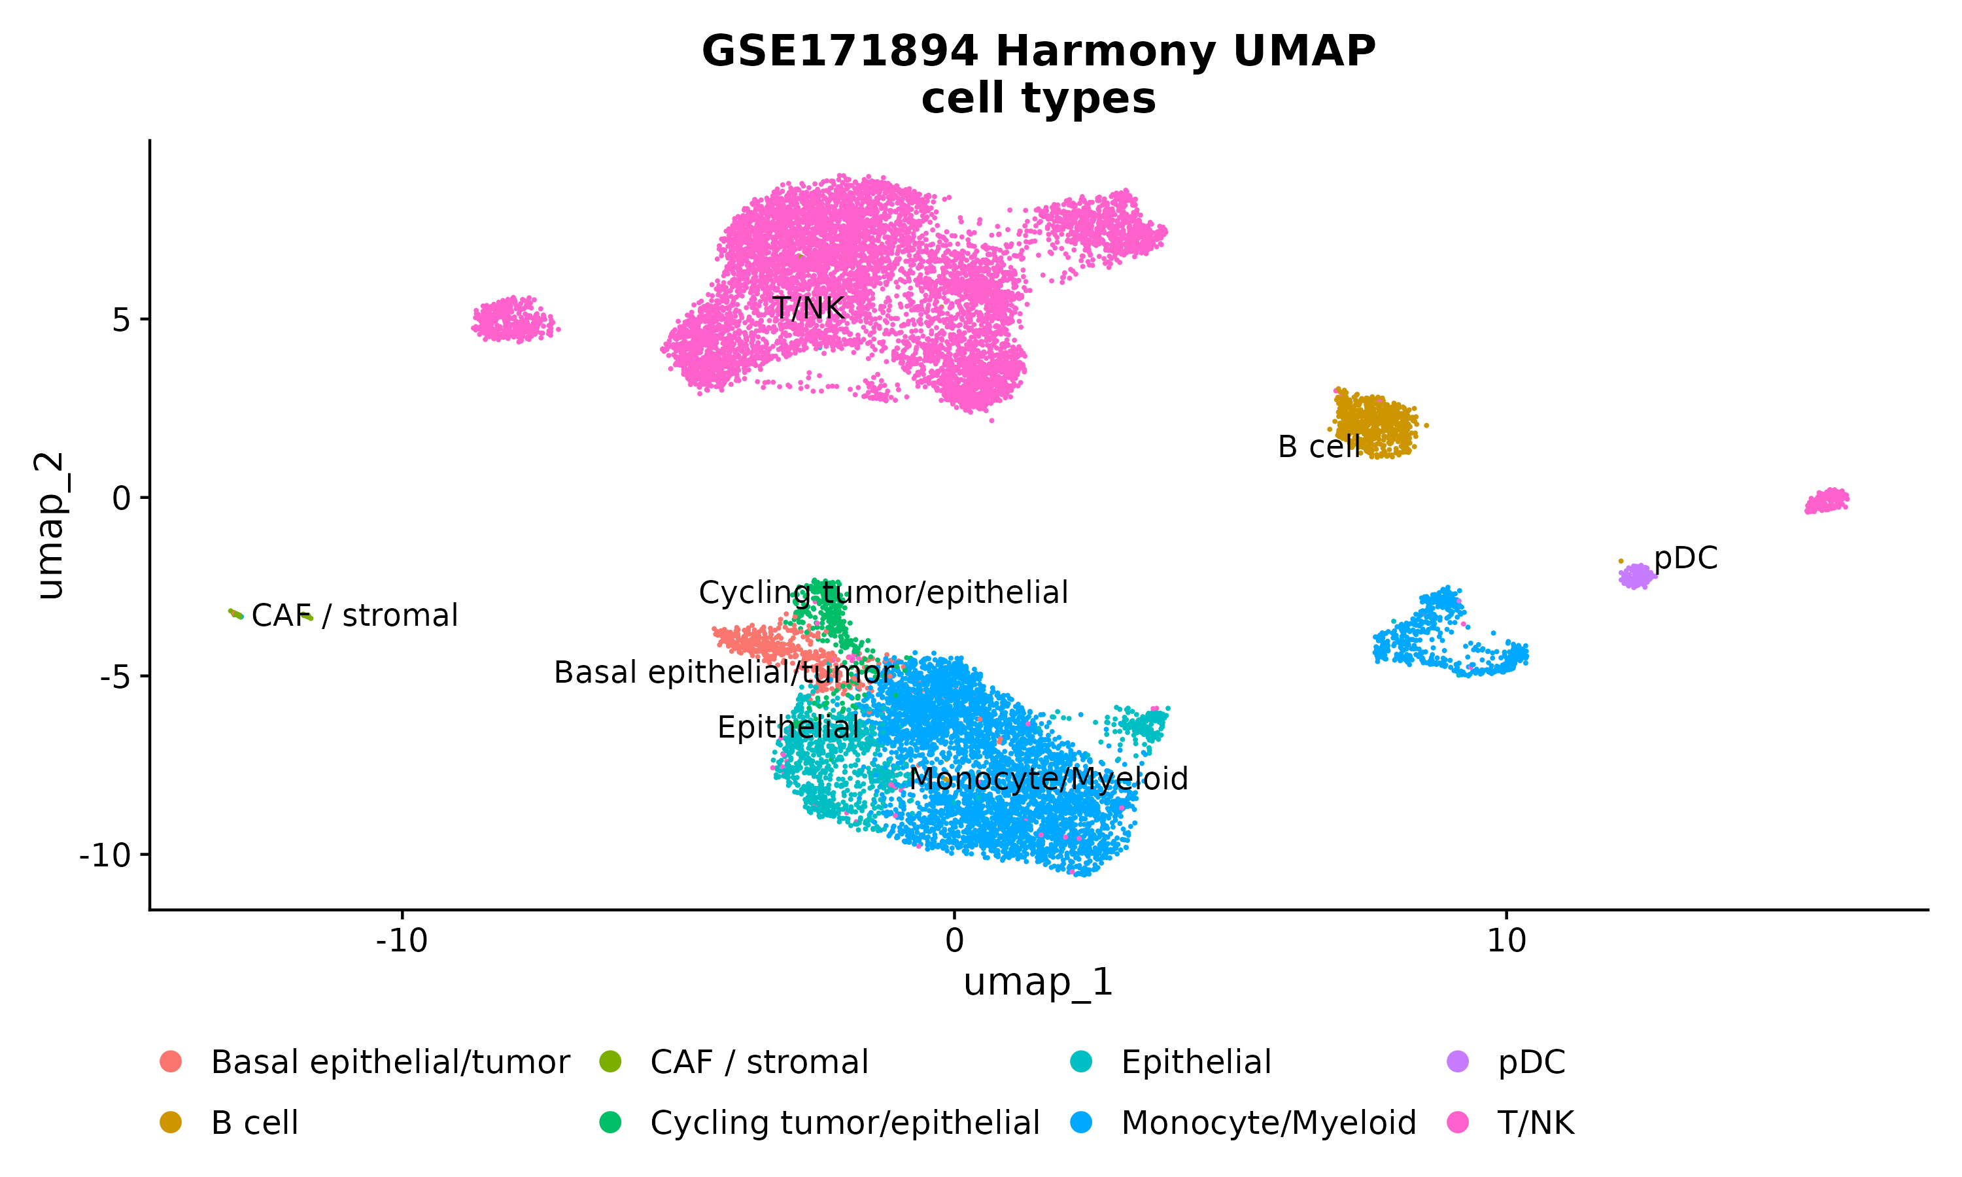
Cells were annotated using marker genes and CellMarker*.
*Clusters 7, 9, 11 and 15 were manually annotated due to impossible cell types (neuronal, embryonic, testis)

Slide 11

Catalogs R-loop regulator genes from PubMed articles.
Scores evidence strength based on number of studies/assays.
Links gene regulators to specific R-loops.
We will use their full R-loop regulator gene list and assign each of our cells a score based on the corresponding gene expression.
https://doi.org/10.1093/nar/gkab1103

Slide 12
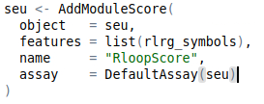
R-loop scores per cell
Average normalized expression of 1,095 RLRG genes
Subtract average of a control gene set matched by expression level
Relative score: Higher ~ enriched RLRG expression relative to background

Slide 13
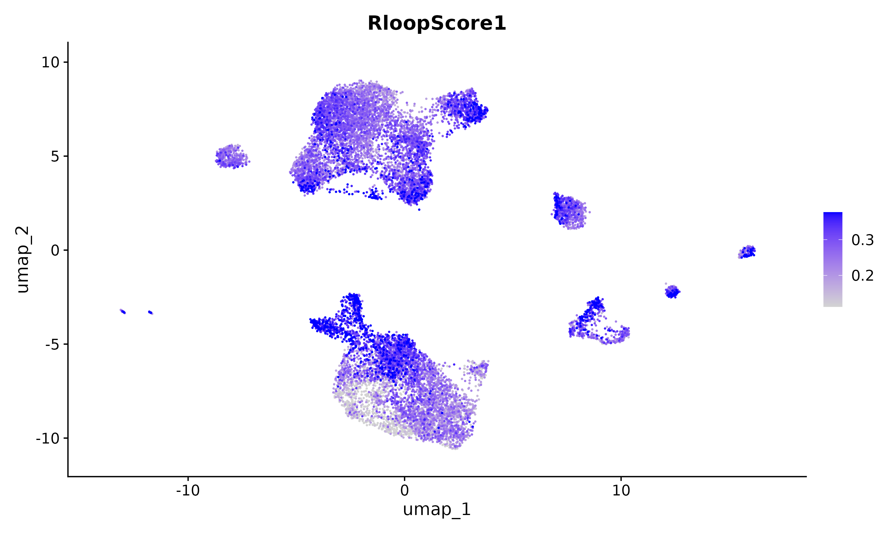

Slide 14
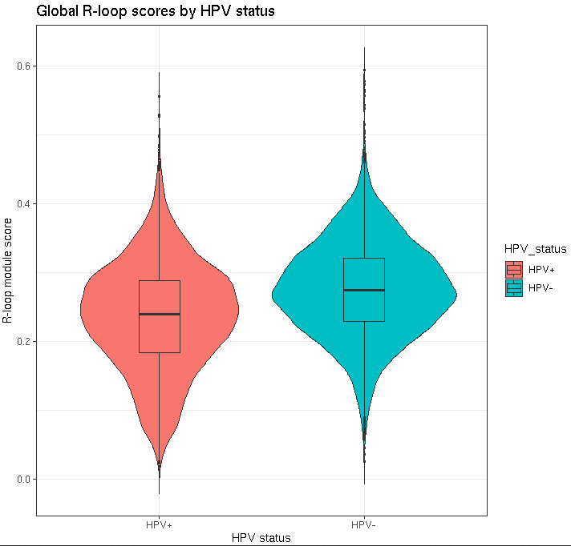

Slide 15
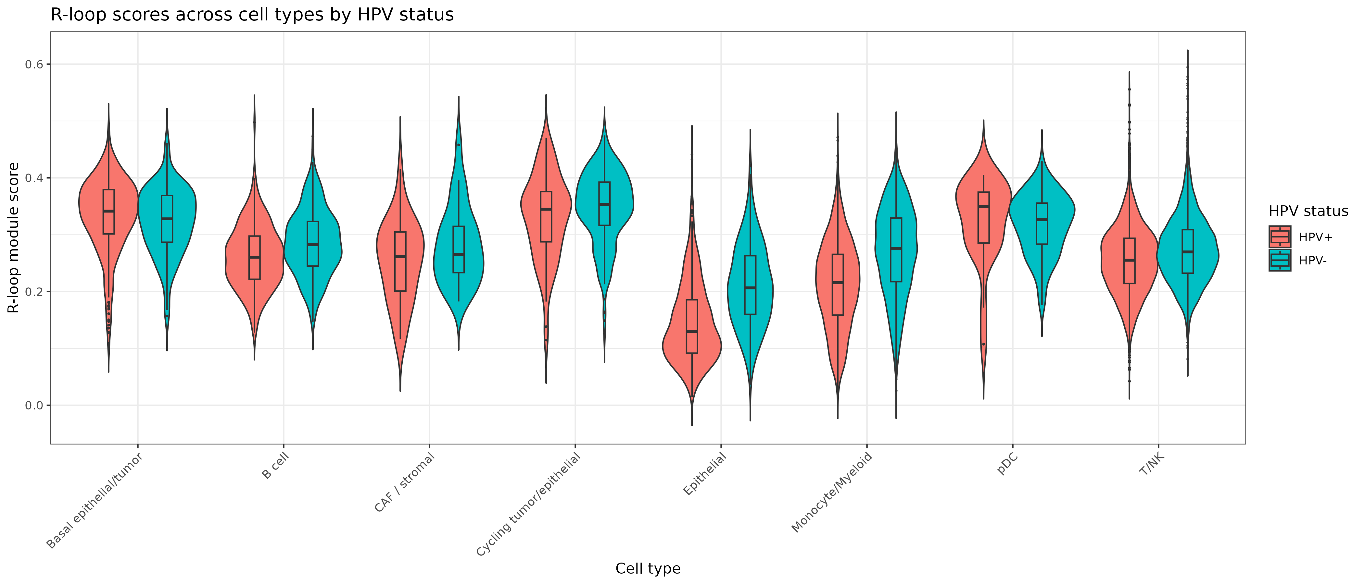



Malignant

Slide 16
Hypotheses
H1: HPV-positive tumors have higher R-loop scores (based on RLRGs regulator genes ) than HPV-negative tumors in malignant cells.
Notes: Our evidence fails to support this hypothesis.
-Chen et al. originally used WGCNA to subset the ~1,000 RLRG to ~100 RLRGs that are highly correlated with HBV – we just went with all RLRG.
-Chen el al. also had a better idea of which cells were malignant by analyzing CNV – we used very coarse labels.
-Viral lifecycle dependence? (more on this later)

Slide 17
Hypotheses
H1: HPV-positive tumors have higher R-loop scores (based on RLRGs regulator genes ) than HPV-negative tumors in malignant cells.
H2: In HPV-positive tumors, high R-loop scores are associated with:
higher T cell exhaustion signatures in CD8 T cells
lower antigen presentation (MHC) in malignant cells
overall more immunosuppressive TME

Slide 18
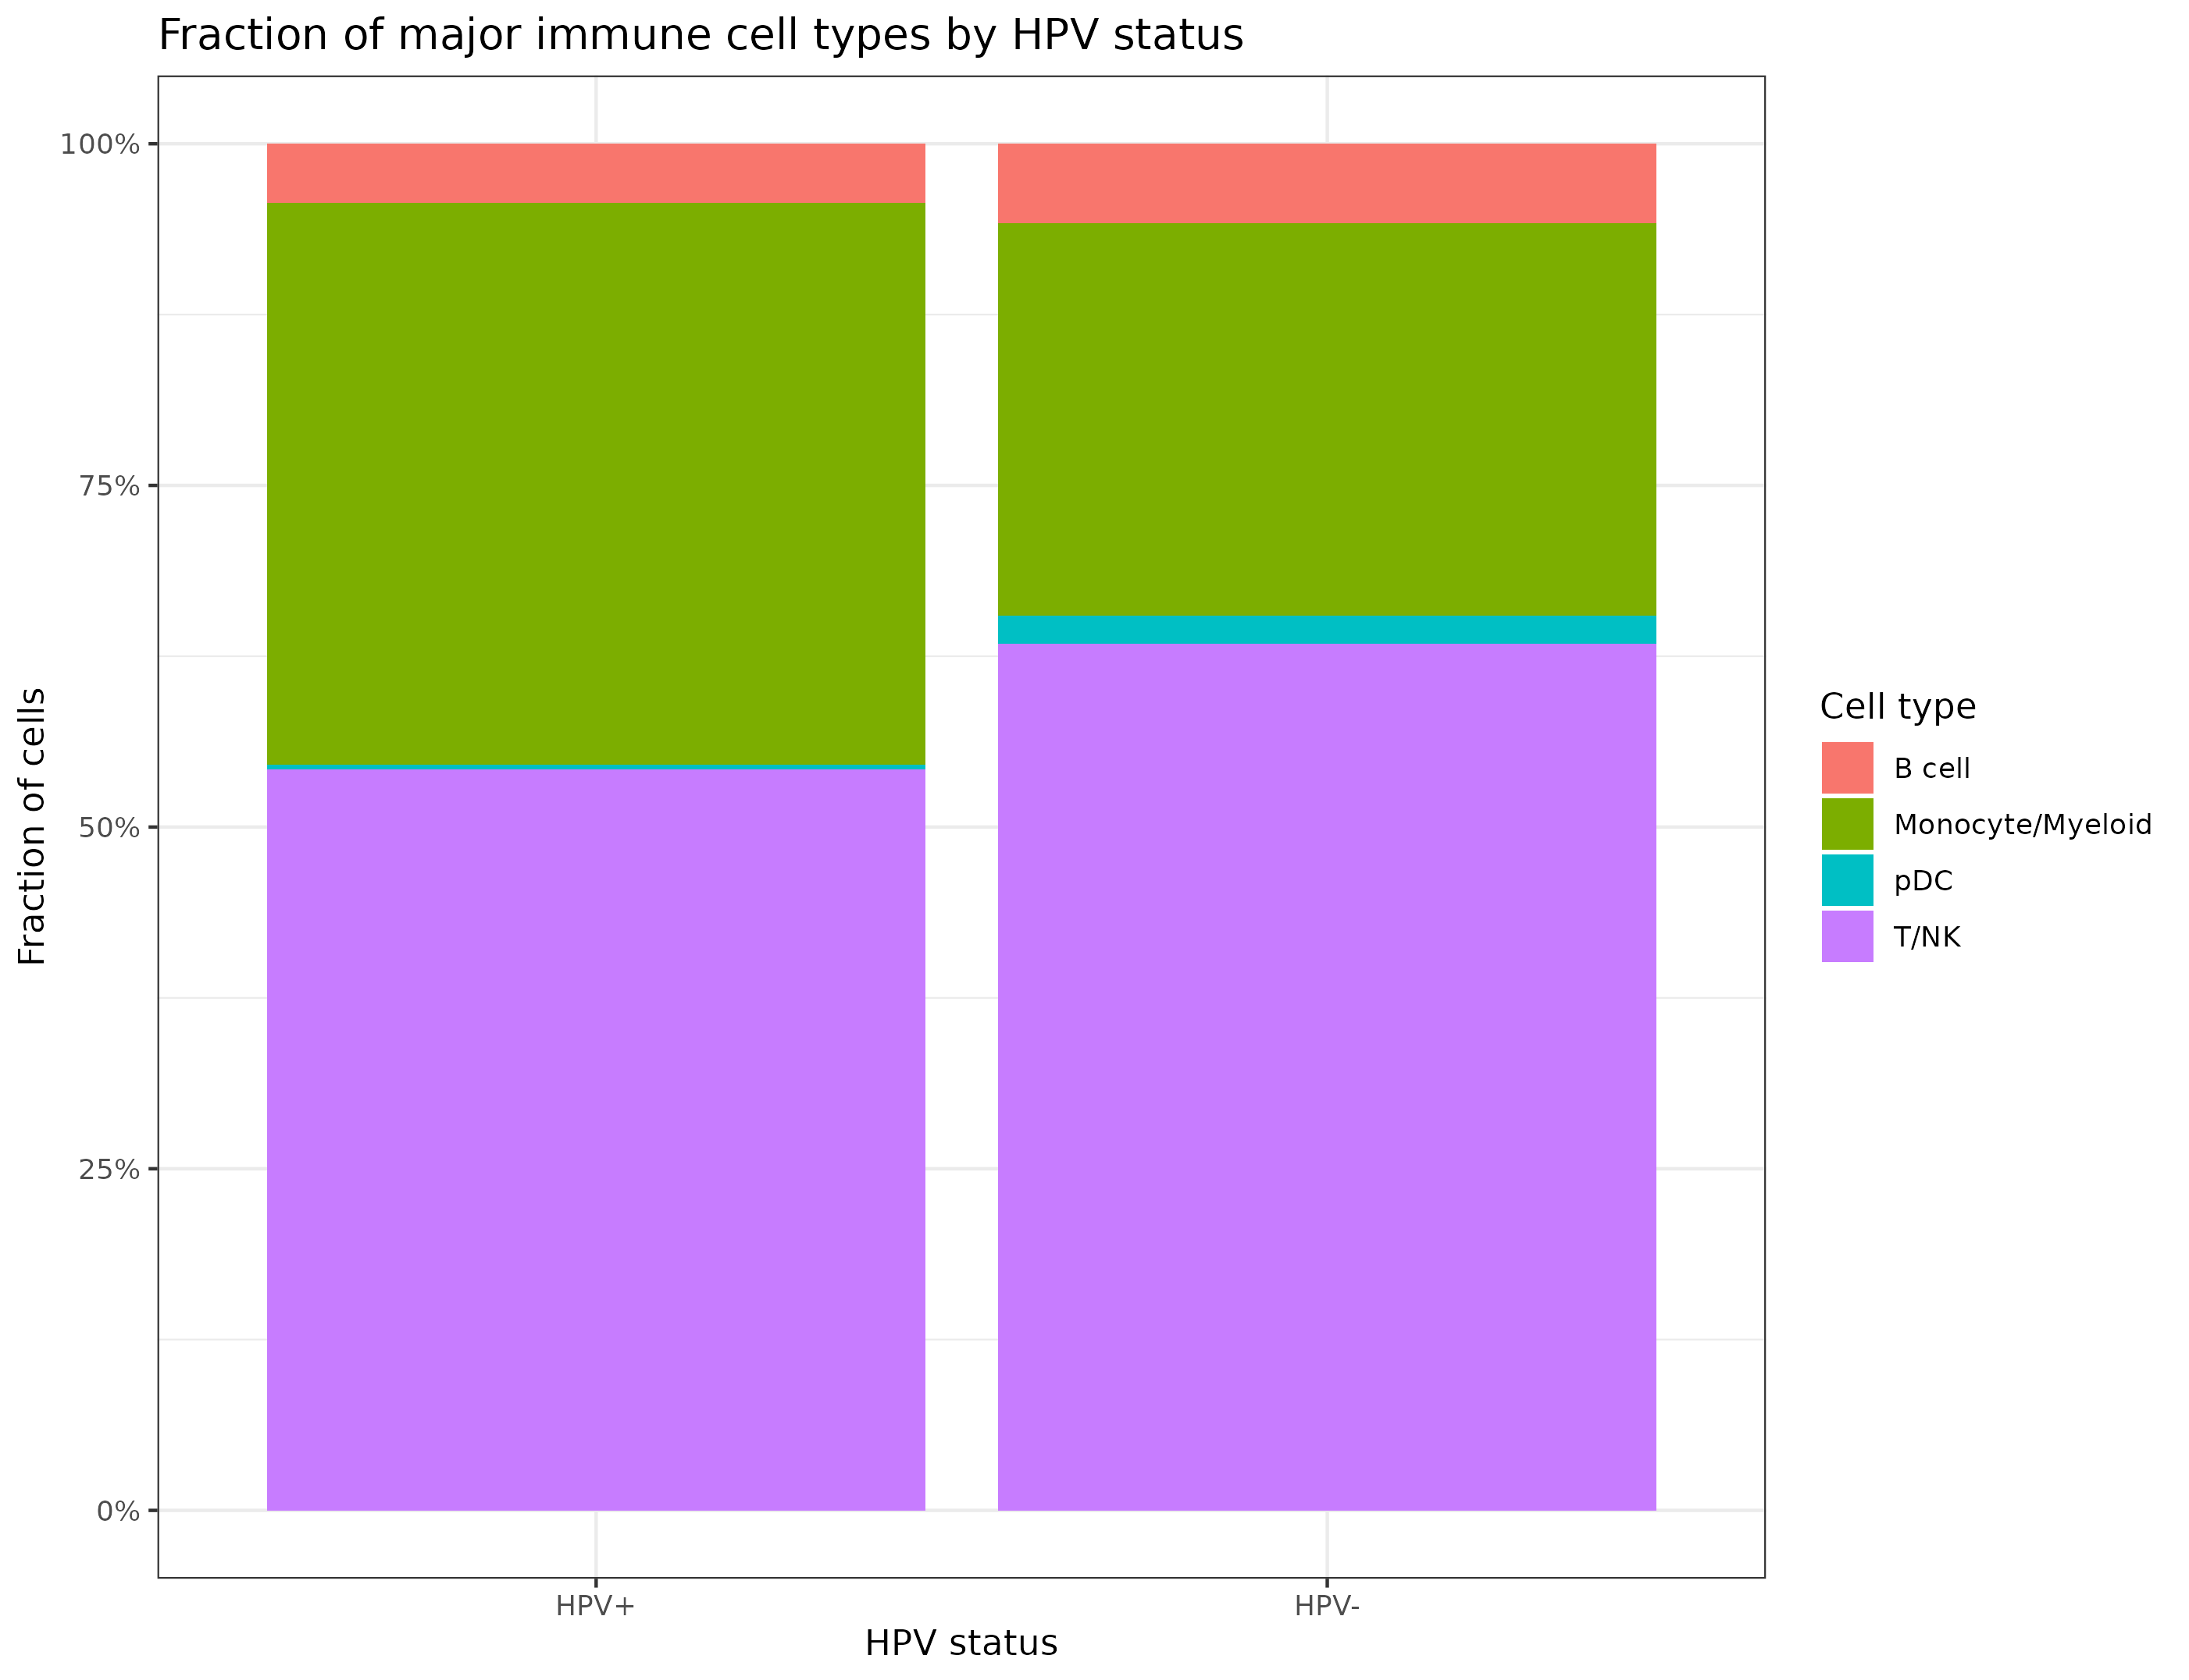

Slide 19

Please don’t ask me about immunology
Fonzie jumps over a shark on water skis in Happy Days episode “Hollywood: Part 3” (Season 5, Episode 3)

Slide 20
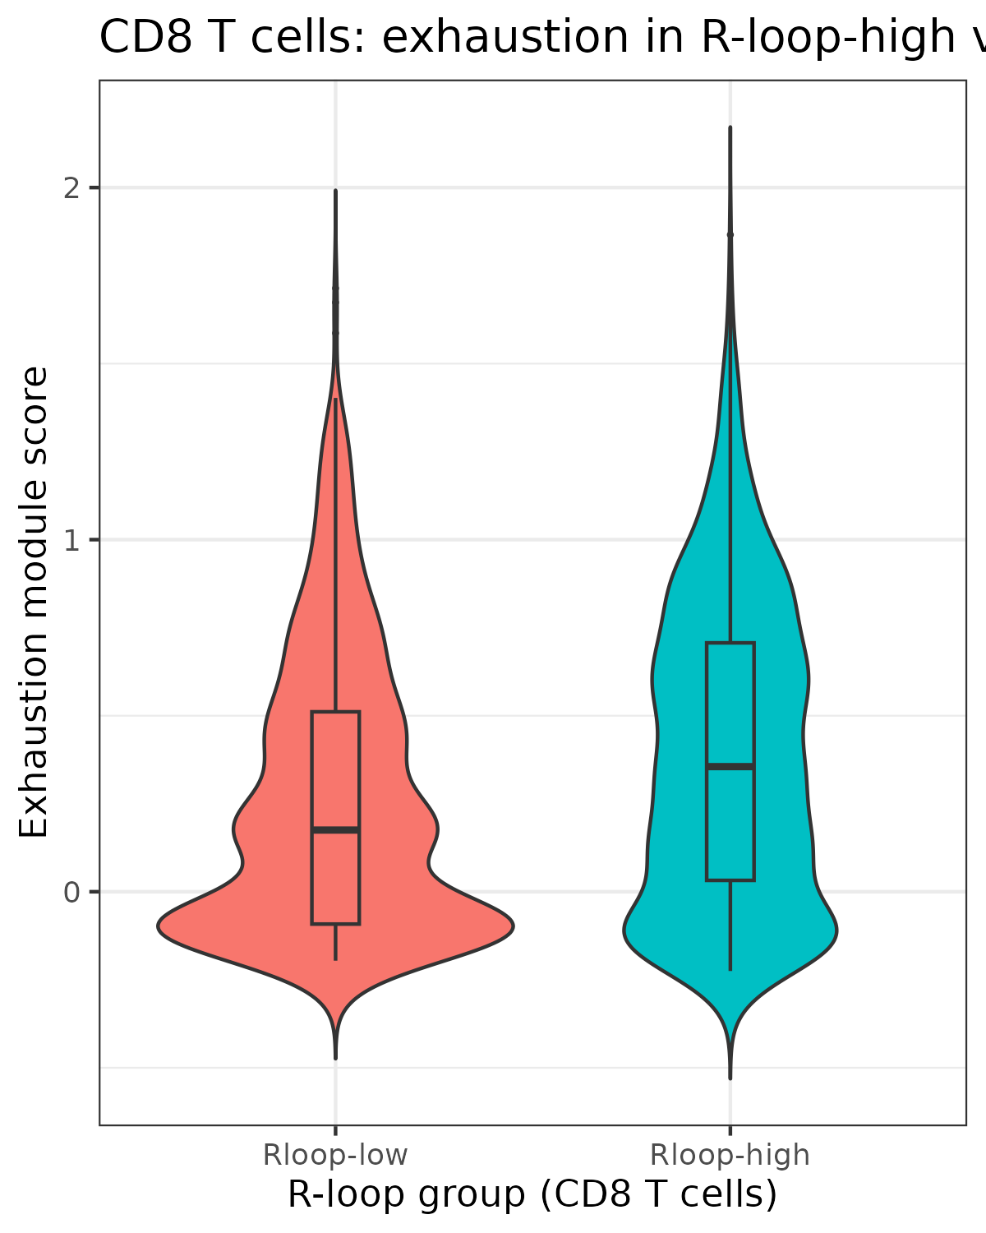
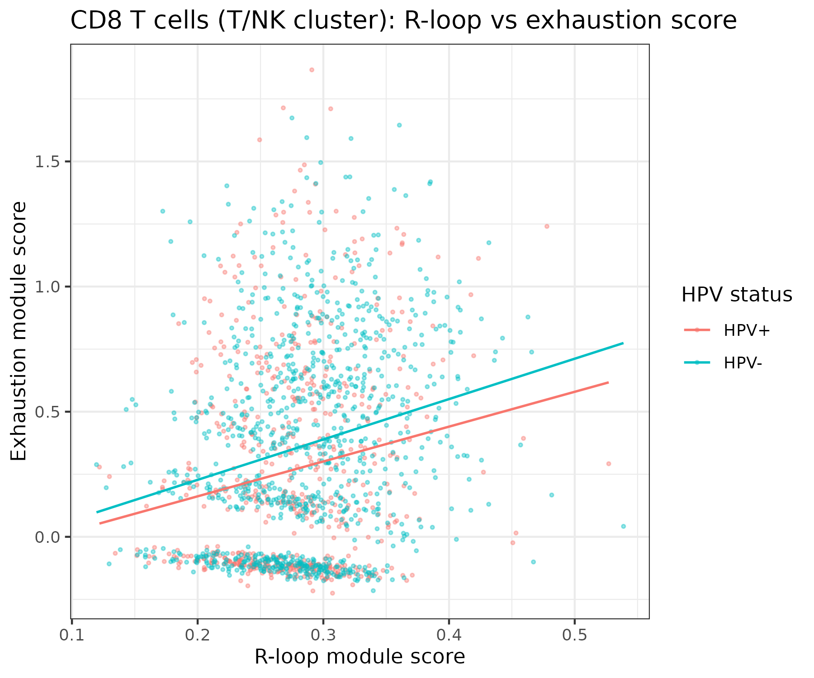
H2: In HPV-positive tumors, high R-loop scores are associated with:
higher T cell exhaustion signatures in CD8 T cells Sort of.

Slide 21
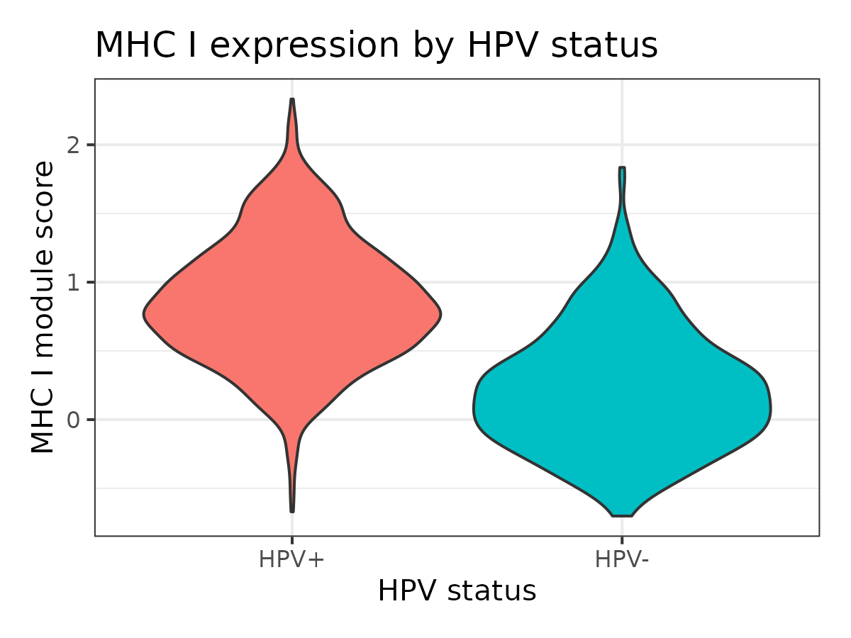
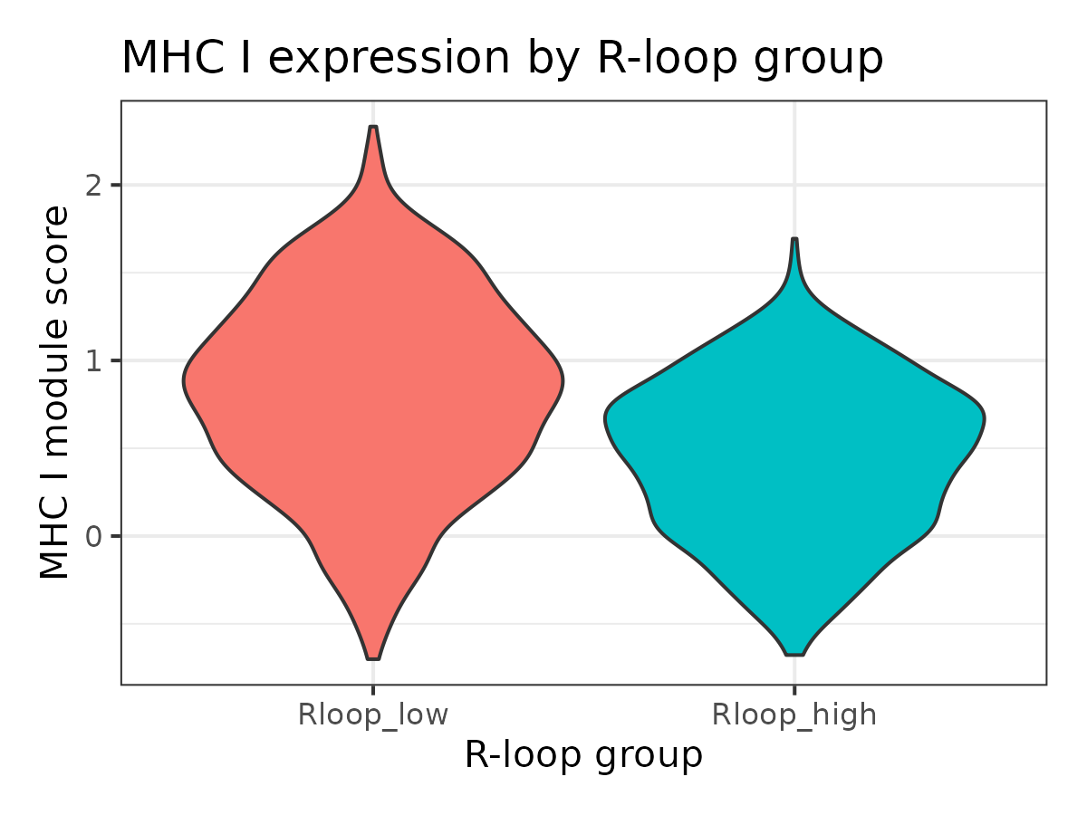
H2: In HPV-positive tumors, high R-loop scores are associated with:
lower antigen presentation (MHC) in malignant cells Yes.

Slide 22
Main findings
Discussion
R-loop scores (as we defined them) were ostensibly higher in HPV- tumors – contrary to the HBV story.
R-loop scores had okay results for tracking TME metrics such as T cell exhaustion / reduced antigen presentation.
We had trouble replicating Chen et al.’s story from HBV for HPV.

Slide 23
Intuitions from this
Discussion
“episomal” {E2 ↑ & R-loops ↑} implies currently {E6↓, E7↓} implies no p53 mutation -> no cancer (yet)
“integrated” {E2↓ & R-loops ↓} implies {E6 ↑, E7 ↑} implies p53 mutation -> cancer.
The R-loop scores should indicate specifically where viral integration is occurring, which translates to spatial transcriptomics much better.
I speculate the negative result from this analysis was naively applying hepatitis-B ideas to HPV.
I hypothesize we can localize where viral integration is occurring using R-loop scores.

Slide 24
Limitations
Single dataset only. N = 4. Cervical tissue only.
R-loop score is an indirect proxy (expression-based), not direct R-loop mapping.
Correlative, not causal.

Slide 25
Future Directions
Explore the division of labor between E2 and E6/E7 genes in establishing the R-loop enrichment of HPV+ cells. Specifically: Use an independent TCGA bulk RNA-seq data set. Compare integration-high vs. integration-low using metrics like RLRG expression and TME markers.
Spatial transcriptomics to interrogate where R-loop high tumor cells sit relative to immune cells.
Use inferCNV to distinguish tumorous epithelial cells.
Using head and neck cancer to get larger sample sizes (more HPV- tumors).

